Slide 1

Oauth 2.0

Slide 2
Authentication?
OAuth
Authorization?

Slide 3
Authentication
Authentication is the process of determining whether someone or something is, in fact, who or what it says it is.
Authorization
Authorization is the process of giving someone the ability to access a resource.

Slide 4
Authentication
OAuth
Authorization

Slide 5
OAuth
Open Authorization
The OAuth 2.0 authorization framework is a protocol that allows a user to grant a third-party web site or application access to the user's protected resources, without necessarily revealing their long-term credentials or even their identity.

Slide 6
Authorization
between
Services
OAuth
Why do we need authorization between services ?????

Slide 7

Hey gimme users pics
Photo
Printing
Website
Google
Drive
Service
No!!!
Hey! Can you give me your Google_ID & password
Nah bro

Slide 8
How it works

Slide 9


Lets take an example valet key parking
Hey can you park my car ?
Yep, gimme the keys

Slide 10


Valet key
Master Key
I’ll give you the valet key

Slide 11
Car Owner
Car
Valet
Limited Access

Slide 12
OAuth Flow

Slide 13
Hey give me users pics
Photo
Printing
Website
Google
Drive
Service
No!!!!
Stop asking

Slide 14
With OAuth Implementation

Slide 15
Hey give me users pics
Okay you have access now
Photo
Printing
Website
Google
Drive
Service
Yep
Allow!
Hey this service wants access,
Should I allow ??

Slide 16
Gimme users pics
Here is a token for next time
Photo
Printing
Website
Google
Drive
Service
TOKEN
TOKEN
Authorization Token
(Limited Access)

Slide 17
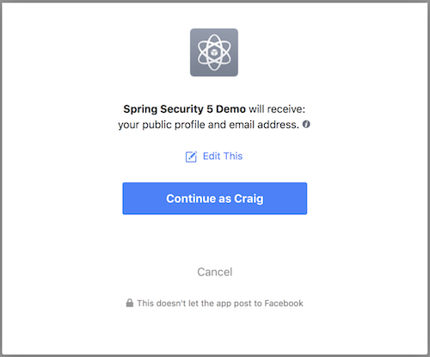

Slide 18
OAuth Access Token
Contains user-allowed permissions
Trustable (cannot be tampered)
JWT
Jason Web Token

Slide 19
Authentication
OAuth
Authorization

Slide 20
Terminologies

Slide 21
1.Resource

Slide 22

Photo
Printing
Website
Google
Drive
Service
Photos

Slide 23
2.Resource Owner
An entity capable of granting access to a protected resource

Slide 24
Photo
Printing
Website
Google
Drive
Service
Resource Owner

Slide 25
3.Resource Server
The Server hosting the protected resources

Slide 26


Photo
Printing
Website
Google
Drive
Service

Slide 27
4. Client
An application making protected resource requests on behalf of
The resource owner and with its authorization

Slide 28

Client
Photo
Printing
Website
Google
Drive
Service

Slide 29
Who has the burden of security ?

Slide 30
Client
Google
Drive
Service
Photo
Printing
Website
Resource Server
Authorization server
Resource Owner

Slide 31
5. Authorization Server
The Server issuing access tokens to the client

Slide 32
OAuth Flows

Slide 33
OAuth Flow 1
Authorization Code Flow

Slide 34
Photo
Printing
service
1
Auth Token
6
9
Access Token
5
8
7
2
Auth Token
API Call
Access Token
Google
Drive
Service
Authorization server
3
4

Slide 35
OAuth Flow 2
Implicit Flow

Slide 36
Photo
Printing
service
1
2
Access Token
5
6
7
Access Token
Google
Drive
Service
Authorization server
3
4

Slide 37
Implicit Flow
Not as Secure
Primarily used with short-lived access tokens
Used with JavaScript Apps

Slide 38
Next flow is our big use case
i.e.,
Authorization between microservices

Slide 39
OAuth Flow 3
Client Credentials Flow
When the client is well trusted

Slide 40
Access Token
Auth
Service
2
1
Microservice 1
Microservice 2
3
Access Token
database
4

Slide 41
Now lets implement this using SpringBoot

Slide 42
Create a Client Application
Go to start.spring.io
Add needed dependencies in pom.xml
Generate project
Configure the Spring security for the client
Implement the Authorization Server
Go to start.spring.io
Add needed dependencies in pom.xml
Generate project
Configure the OAuth server
Lets register a client app in the authorization server
Configure the spring security for OAuth server

Slide 43
Configure the Client Application
Configure the client app according to the properties given in the Oauth server
Add these properties in application.properties/yml
Configure the Spring security according to the requirement
Create an OAuth Resource Server
Go to start.spring.io
Add needed dependencies in pom.xml
Generate project
Configure OAuth Resource server
Add required properties to the application.properties/yml
Add Connection between the two apps/microservices
Configure the webclient for authentication

Slide 44
Slides Source:
https://www.youtube.com/watch?v=X80nJ5T7YpE
Code Source:
https://www.youtube.com/watch?v=MOCeQYbQPPU
https://github.com/shabbirdwd53/spring-security-tutorial.git
Other References:
https://developer.okta.com/blog/2017/06/21/what-the-heck-is-oauth
https://howtodoinjava.com/spring-boot2/oauth2-auth-server/
https://docs.spring.io/spring-security-oauth2-boot/docs/2.0.0.RC2/reference/htmlsingle/
https://developer.fusionfabric.cloud/docs/examples/sample-client-springboot.html (uses Rest Template)
https://developer.okta.com/blog/2021/05/05/client-credentials-spring-security
https://docs.spring.io/spring-security/site/docs/4.2.x/reference/html/ (look 26th point )
https://github.com/TechPrimers/spring-security-oauth-example.git

Slide 45

Thank You!
Rahul Ravindra M

